Slide 1
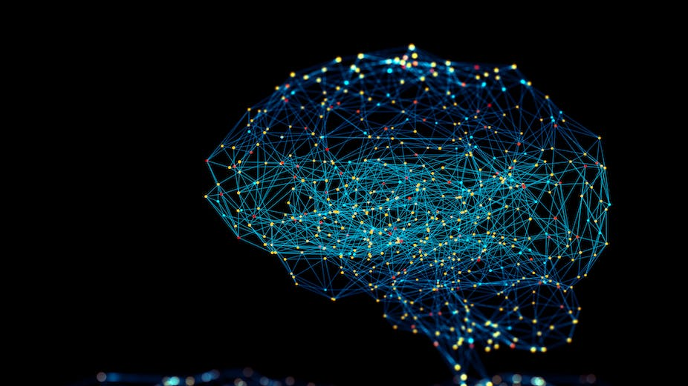

Automated Knee Bone Segmentation using Deep U-Net architectures and Optimized Hyperparameters
Capstone Project Phase 1 23-1-R-2
Supervisor: Prof. Miri Weiss Cohen Group members: Daniel Aibinder Matan Weisberg

Slide 2
Knee Osteoarthritis
Chronic disease in which cartilage, bone synovium, and other joint structures are deformed.
Caused when the cartilage that cushions the end of bones in joints wears down causing friction between knee bones
There is currently no cure for osteoarthritis, and no known cause has been identified

Slide 3
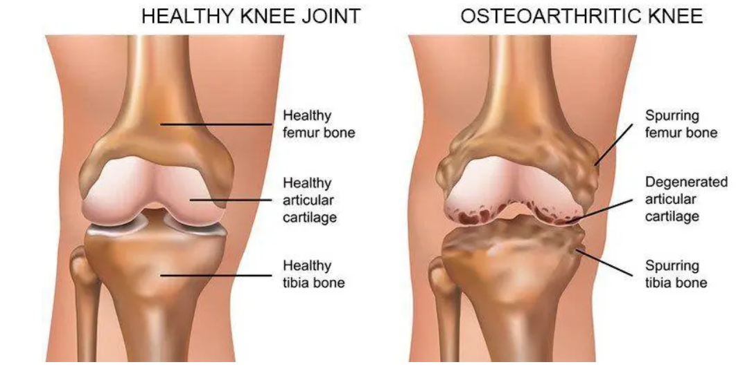
Knee Osteoarthritis
“25% of patients report being unsatisfied with their functional outcomes following treatment.”
“WHO ranked this condition as the eleventh highest contributor of global disability.”
“Leading cause of joint pain among middle-aged and elderly people.”
“average annual cost of $700 - $15,600.”

Slide 4
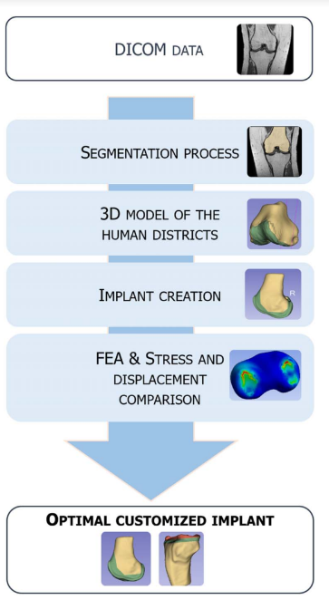
Diagnostics
Currently for an accurate diagnosis of OA, an experienced radiologist
analyzes CT/MRI scans for hours.
Artificial joint replacement has been considered the only treatment option.
In order to create an implant a doctor needs to create a 3D model of the knee,
by segmenting scans with many different slices, making this process greatly inefficient.

Slide 5
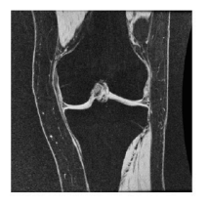
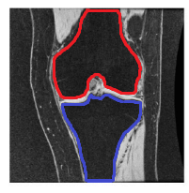
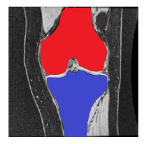
Desired Results

Slide 6
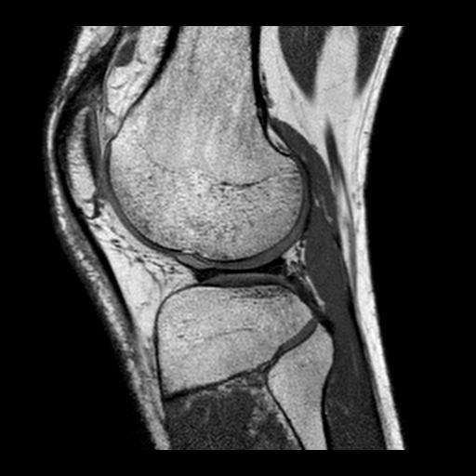
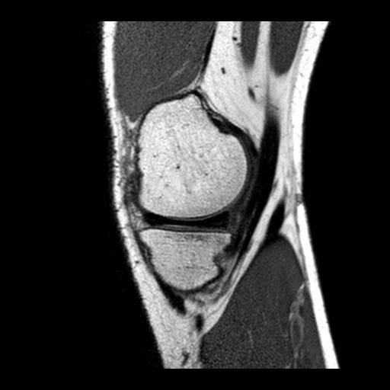
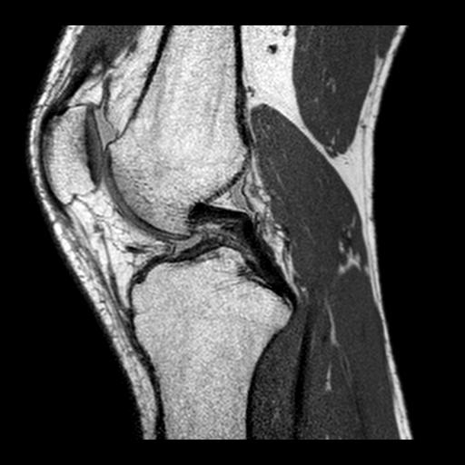
Image Dataset
This study will use the Papa Giovanni Hospital Data Sets of 16,000 images.
The data set contains scan from different views, we will take only the front view as it is the simplest to segment.

Slide 7



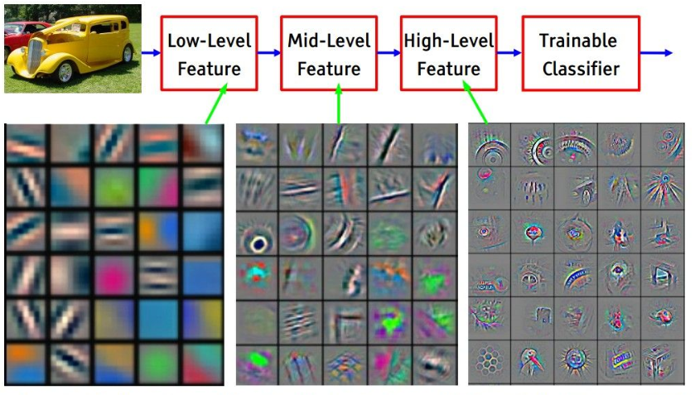
U-Net
The U-Net architecture is a deep learning model developed for image segmentation tasks.
Encoder:
responsible for extracting features from the input image.
Decoder:
responsible for reconstructing the image from the extracted features.
skip connections

Slide 8
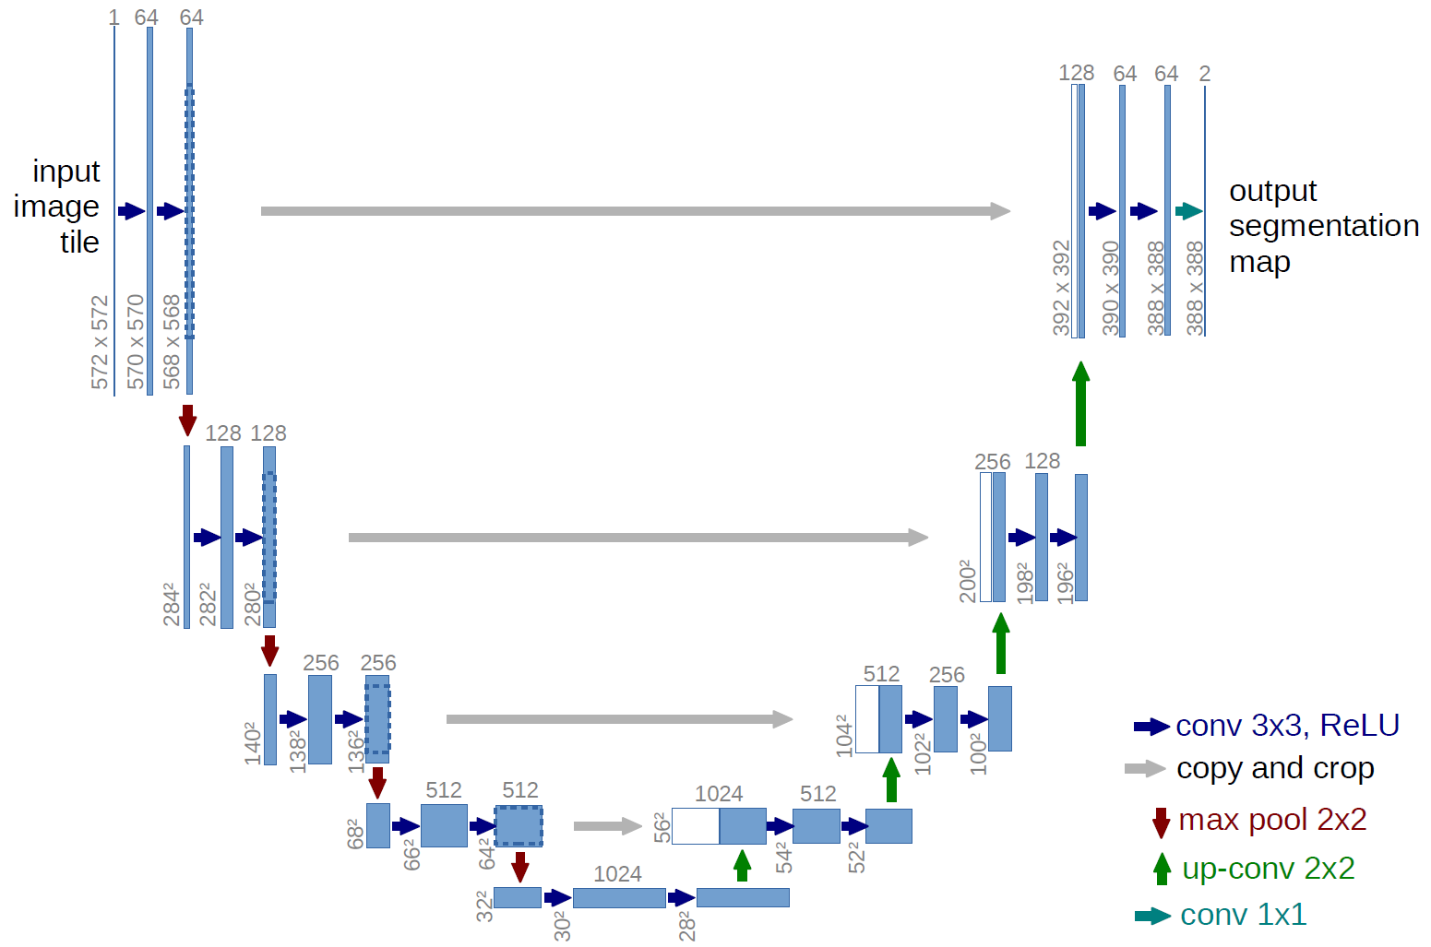
Semantic Gap
Semantic gap- caused by difference between levels of feature map
Low level feature map
High level feature map
The concatenation of two incompatible sets of feature maps causes some inconsistency during the learning time and consequently affects the prediction

Slide 9
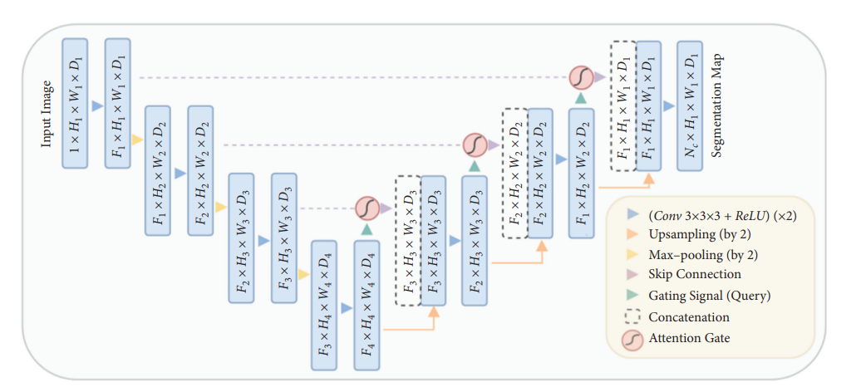
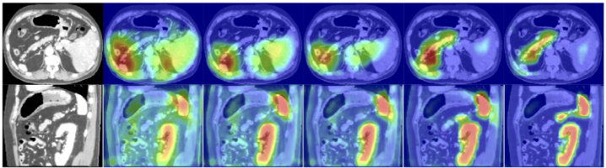
Attention U-Net
Attention at skip connections will actively suppress activations at irrelevant regions.
Attention Gate consists of attention weights which are typically learned during training, indicating how much attention the mod- ule should pay to each part of the input.

Slide 10
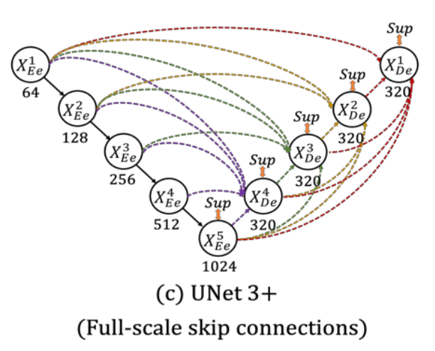
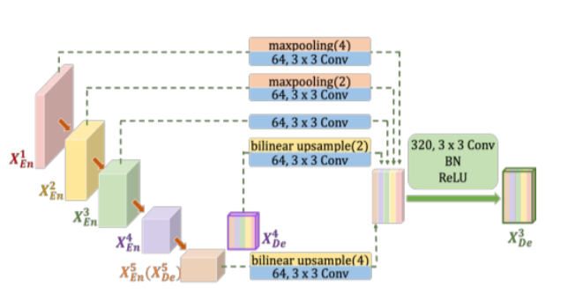
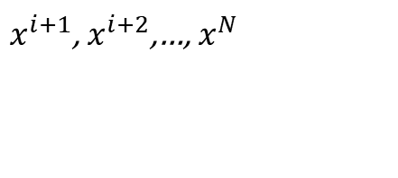
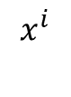
U-Net 3+
$$x^{i}$$
feature map is fed into all the following
Encoder layer
$x^{i+1}$, $x^{i+2}$,…, $x^{N}$
Decoder layers where N is the number of decoder layers.
Similarly, the decoder layers do the same going up the network.

Slide 11
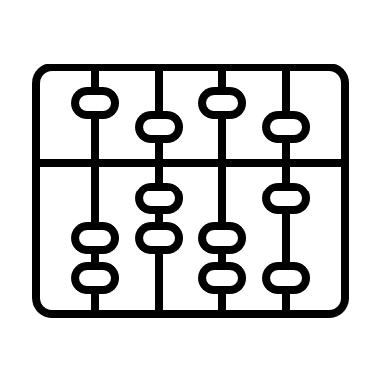





Research Plan
We propose a methodology for automatically segmenting and recognizing the two main bones in the knee, the tibia and the femur.
The work will compare different U-nets.
U-Net 3+
VS
Attention U-net
VS
MD U-net
Few network parameters
Focus on area of interest
Segment edges
Full scale skip connection
Attention gates
Transfer learning

Slide 12



MD U-net
MD U-net improvements:
01
02
03
Transfer Learning
Edge segmentation
Module Enhancements
Pre trained weights for the encoder
Segment bone edges and use post process to segment the inside.
Modified skip connections, deeper layers, more convolutional blocks.

Slide 13
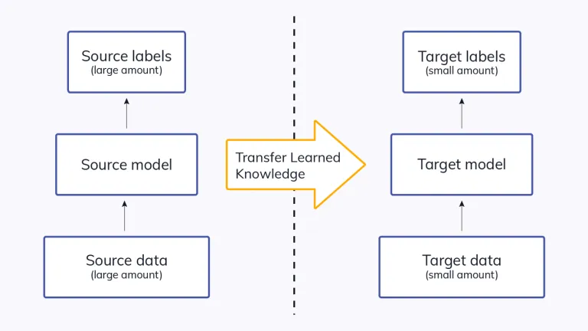


MD U-net
Transfer learning is a machine learning technique that involves using pre-trained models on one task as the starting point for a model on a second, related task.

Slide 14

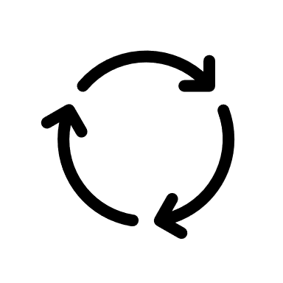

MD U-net
01
Transfer Learning
Novel approach to weight initialization for U-net
Transfer learning is a new concept in U-net. Only a few works use it.
Transfer learning is done by VGG-16. We want to explore transfer learning using other networks
Explore which parts of the U-net weights will be initialized with transfer learning

Slide 15


MD U-net
02
Edge segmentation
Innovation in segmentation
Train the network to segment bone edges while ignoring the inner part of the bone.
Significantly reduce the number of parameters the network holds
Less prone to overfitting due to better generalization

Slide 16
MD U-net
03
Module Enhancements
Benefit from other research works
Change the depth of our U-net
Modify skip connection (residual blocks, full scale jumps, etc.)
Change number of convolutions in each layer

Slide 17


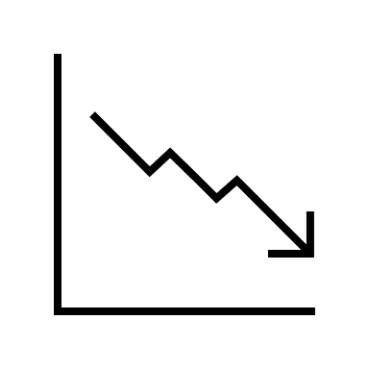
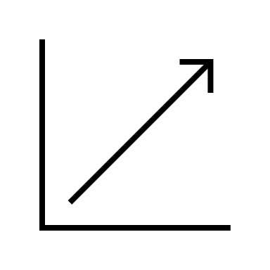
Hyper-parameters
Learning Rate : 0.000001-0.0001
hyper-parameters and their values can have a significant impact on the model’s performance.
Epochs: 50, 100
Batch Size: 32, 64
Loss Function: Dice Loss, Tversky Loss
Evaluation Metric: Jaccard Index, Dice Coefficient
Notes:
During the training of a deep learning model, hyper-parameters are set, and their values can have a significant impact on the model’s performance.
During this research project, different hyper-parameters will be reviewed and compared.
In order to achieve the best results in segmentation, we will propose a set of hyper-parameters

Slide 18
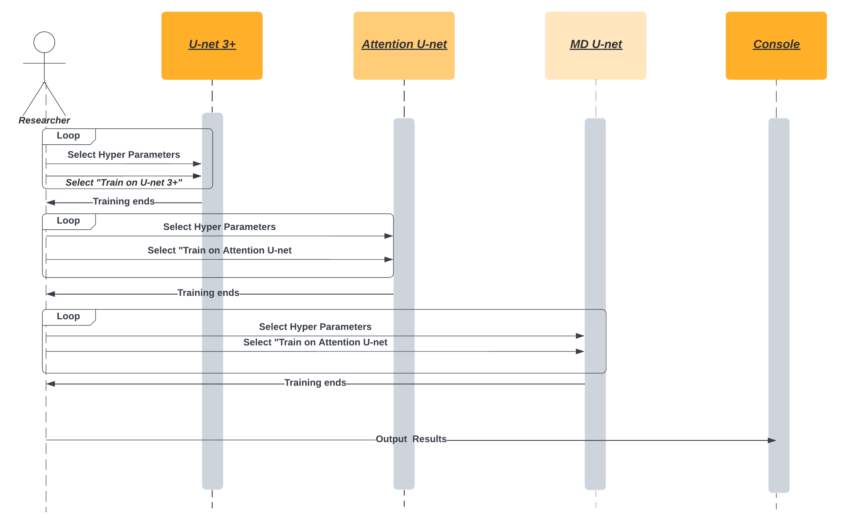
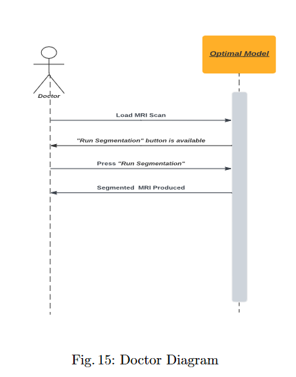
Research process

Slide 19

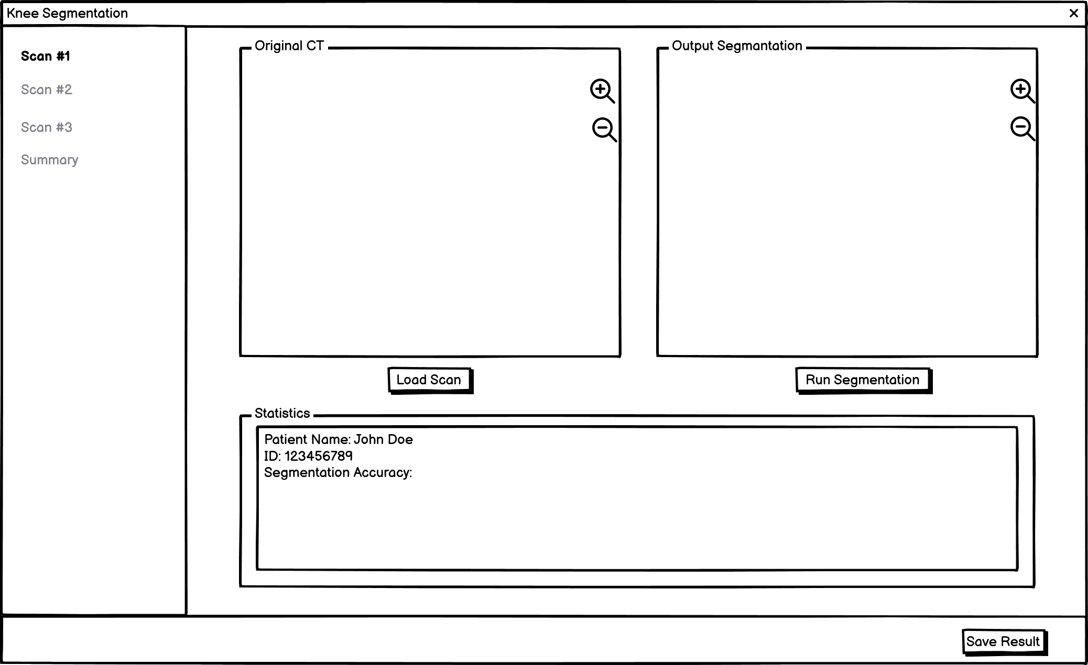
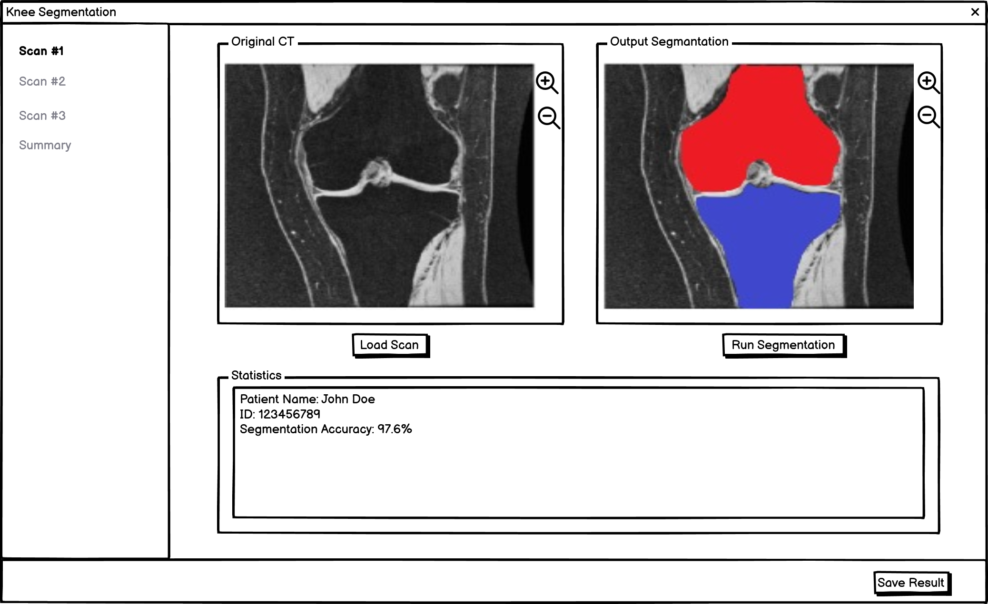
Desired Results
Built with React

Slide 20
Verification Plan
01.
02.
Gui.
Model performance.
Planned verification
Verify program Gui functionality using Cypress a JavaScript end to end testing framework.
Compare the training loss versus validation loss or the training accuracy versus validation accuracy over epochs.
A complete test plan to verify our program and network capabilities.
04.
03.
Back end.
Model comparison.
Compare loss and accuracy between the models.
Unit testing to verify APIs that connect between GUI and the model.

Slide 21

Challenges
In order to succeed our work will need to generate extremely high accuracy.
01
03
High variance of bones in scans.
02
It is hard to determine in advance which model will perform best.
04
Small dataset.
Notes:
Because the results of our work will affect how successful medical treatment will be, we need to generate a high level of accuracy so we no damage will be cause to patients.
Because we cant decide in advance which model will perform best and with what hyper parameters we will need to test them all, and that is a time cosuming task.
Bones shape between human is very different, so it can be difficult for a model to train its weights correctly.
The available dataset is small, may be causing overfitting.

Slide 22



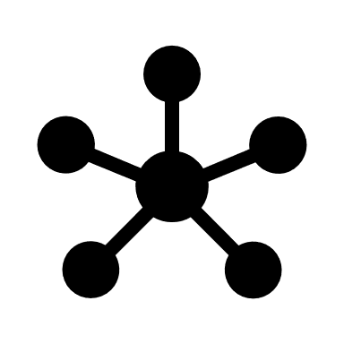


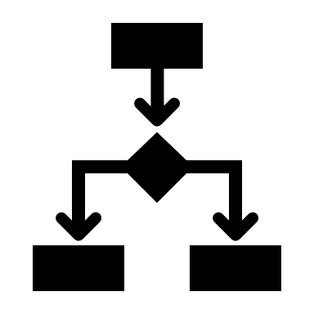



Desired Results
Solution
Deep neural network
Problem
Bone edge detection
Result
Hyper parameter optimization
Bone segmentation takes a long time with current methods.
High accuracy segmentation
Time save for doctors
Lacks accuracy.
Increased patient satisfaction

Slide 23








Summary
Tweak MD U-net
Train 3 different U-net Networks
Tweak hyper-parameters
Compare best results
Build front end
Test and verify accuracy
Test
Connect to our model
.

Slide 24
Thank you. Any questions?
Capstone Project Phase A 23-1-R-2

Slide 25
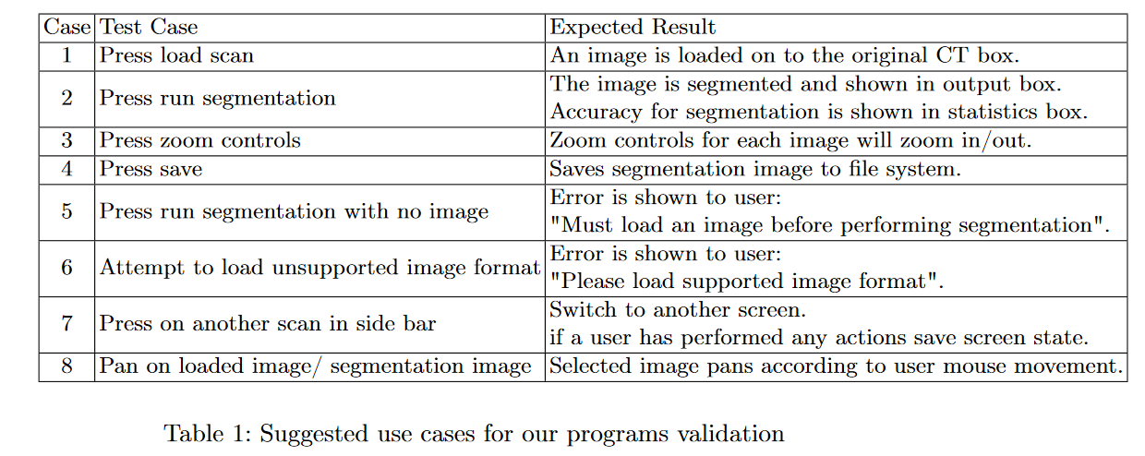
Verification table

